Slide 1
An iOS app to encrypt personal data
- Anirudh nagulapalli

Slide 2

Objective
To avoid data threats
To secure our data from masquerades
Not to make message for the third person available

Slide 3

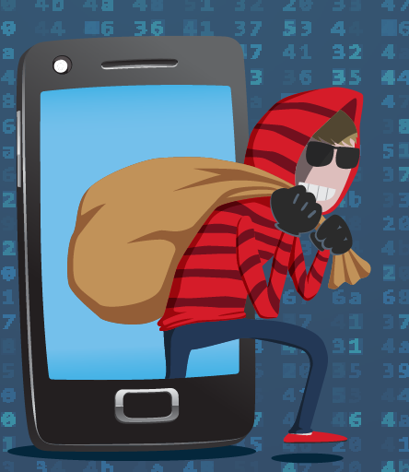
Idea behind the application
The idea behind this application is to provide a secure channel between any two users.
The actual goal was to provide doctors, a way to encrypt their personal information like (Medical license numbers, expiration dates etc) and send them through a secured channel.
Also when referring to another doctor, files such as lab reports etc can also be sent securely.

Slide 4
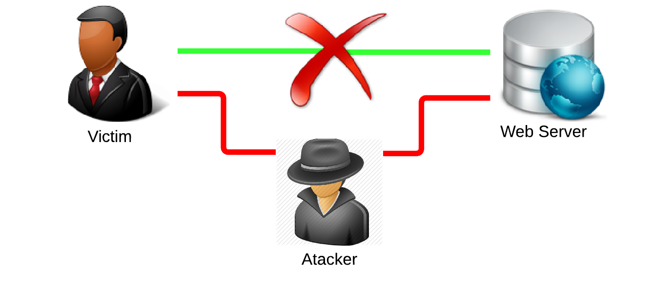
About the application
In this application, Social Security Number is taken as an example
As users don’t like to reveal their Social Security Numbers publicly, they tend to prefer a channel which encrypts their number and sends it as cipher text.

Slide 5
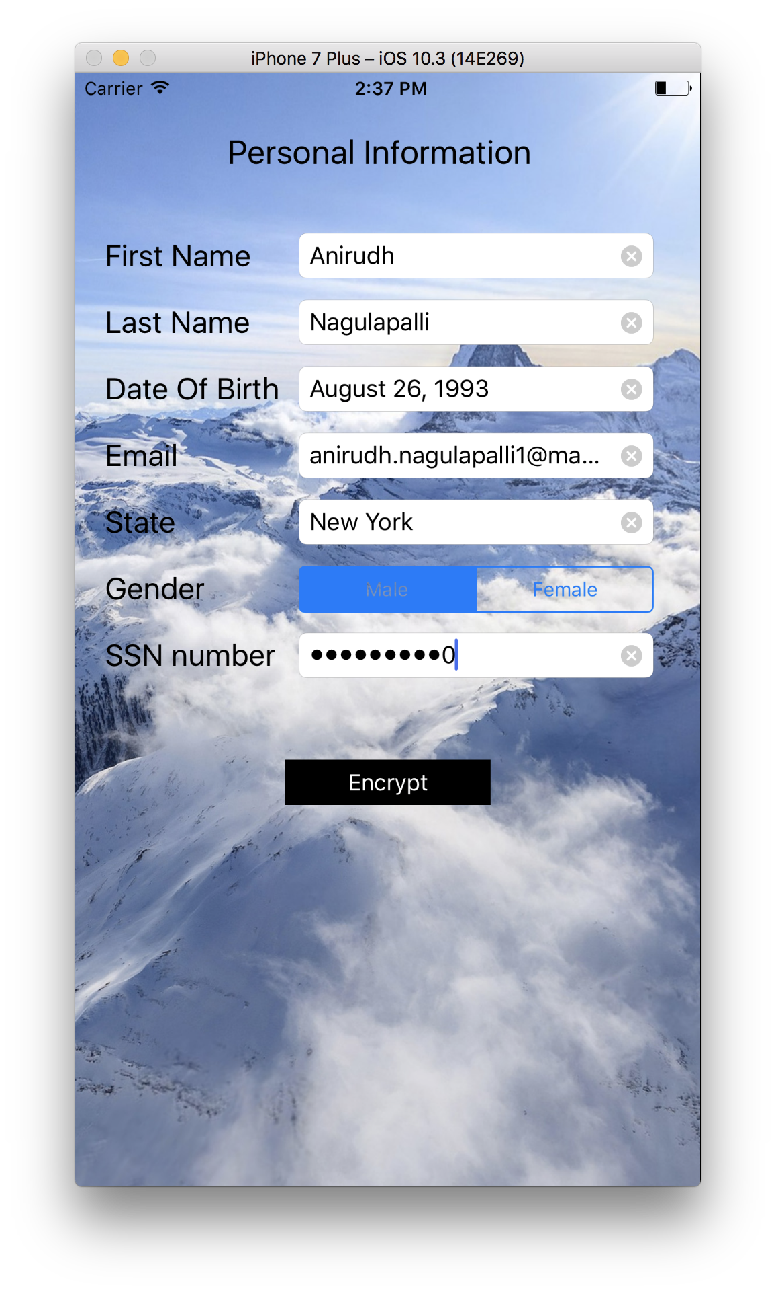
Elements in the application
The UI of the app consisted of
Labels
Text fields
Date Picker
UI Picker
Segmented Controls
Secure Text Entry fields
Buttons

Slide 6
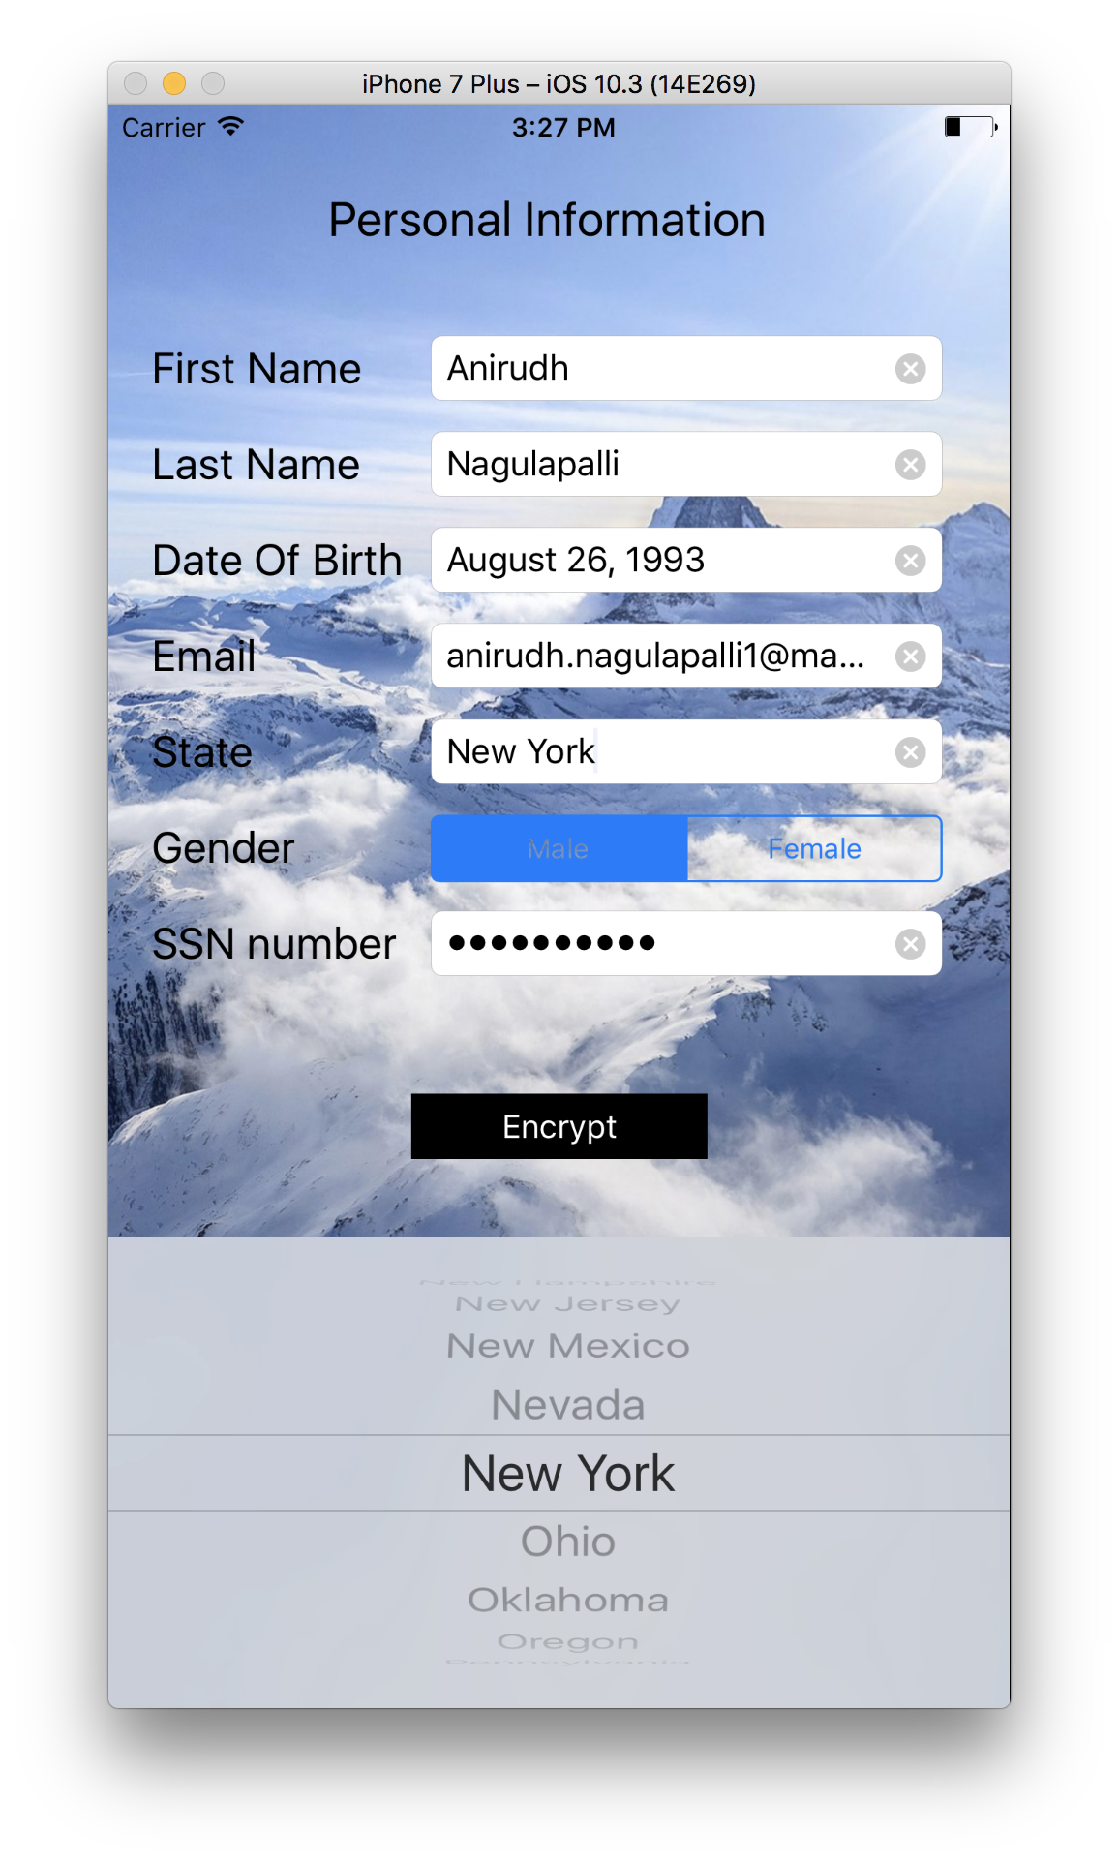
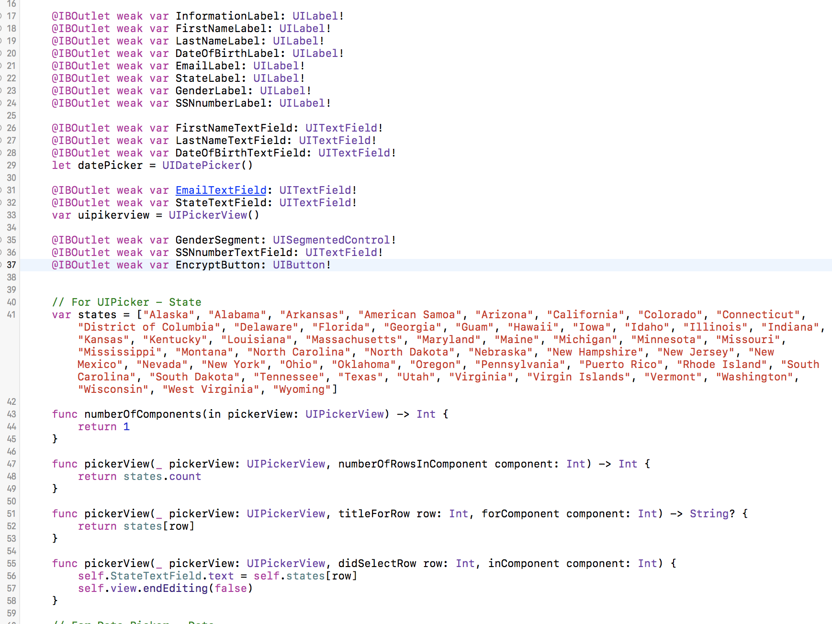
UI Picker

Slide 7
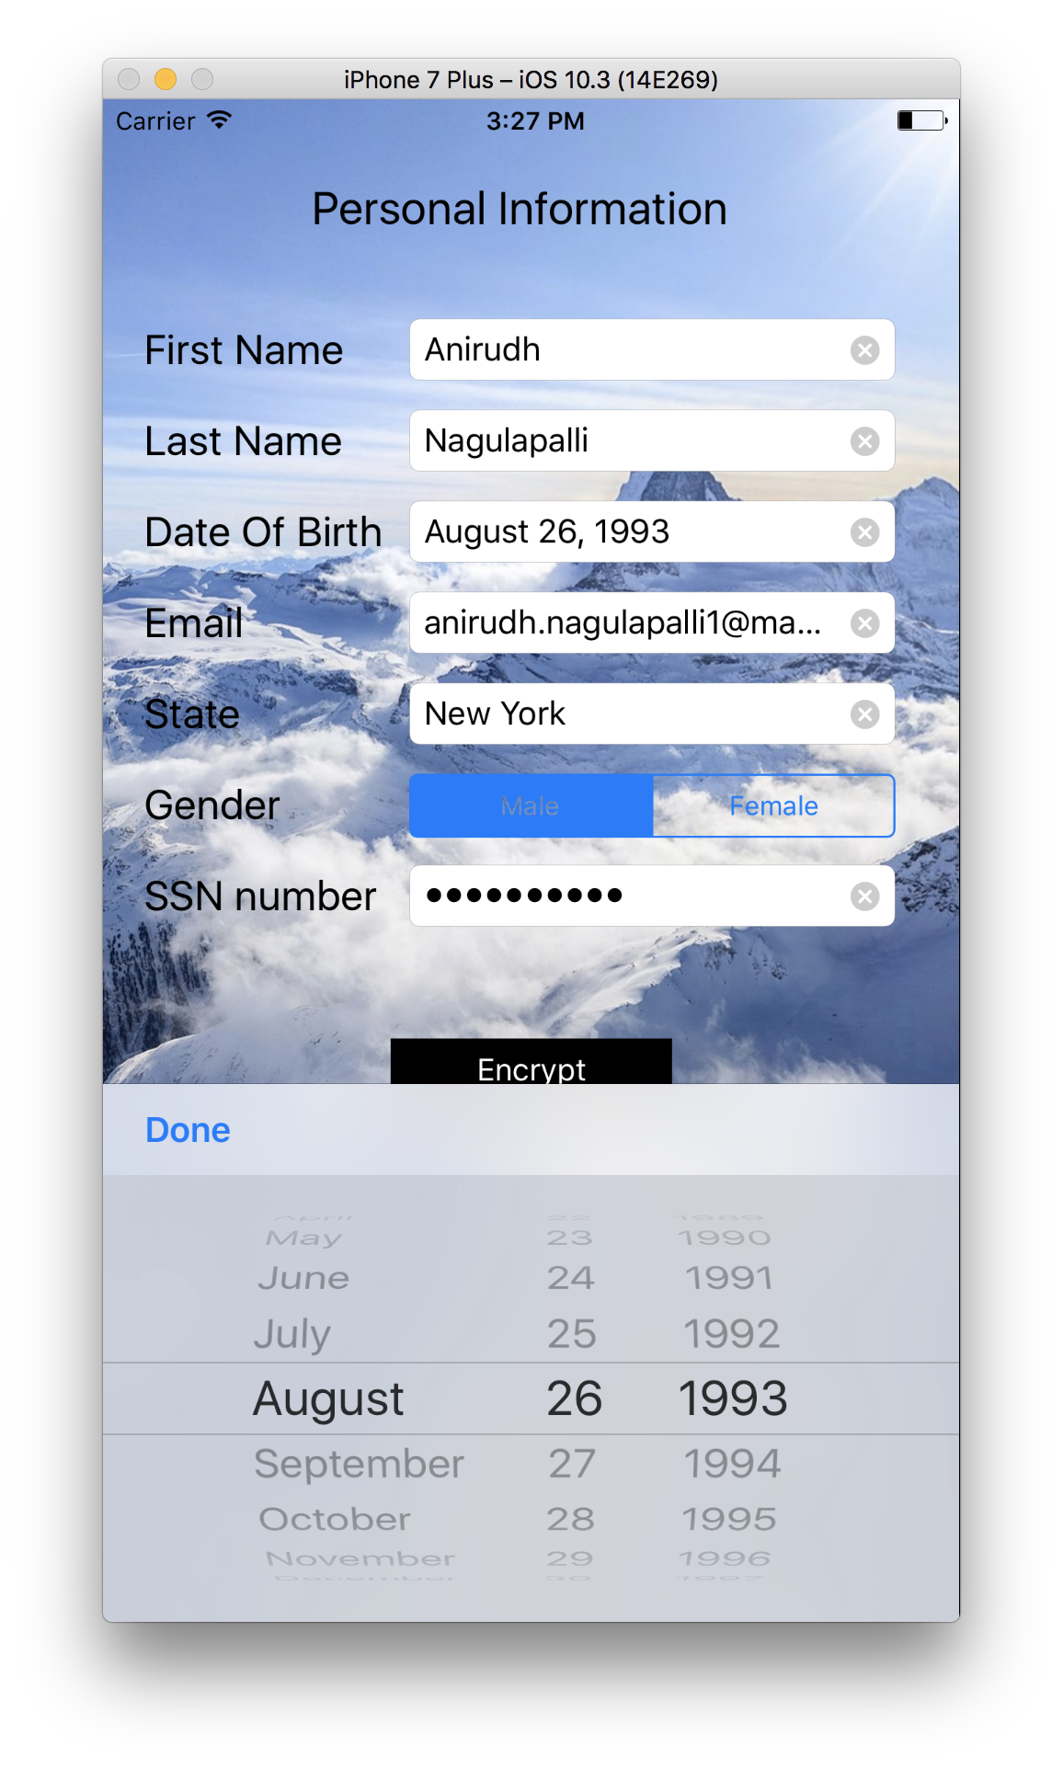
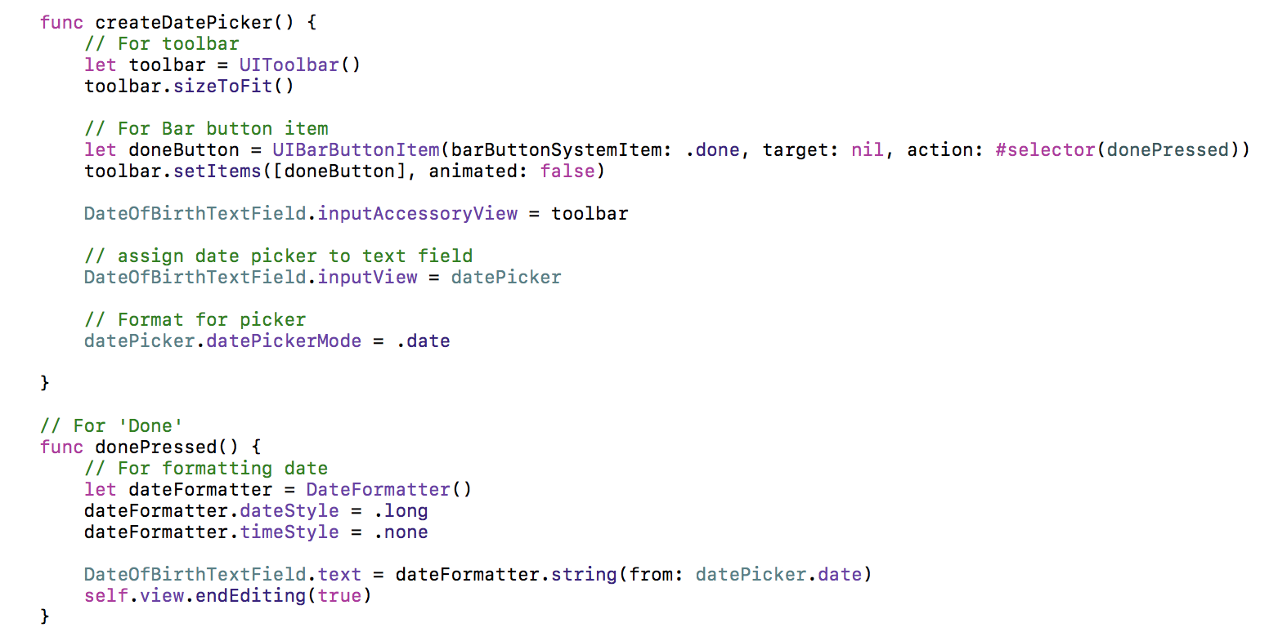
Date Picker

Slide 8
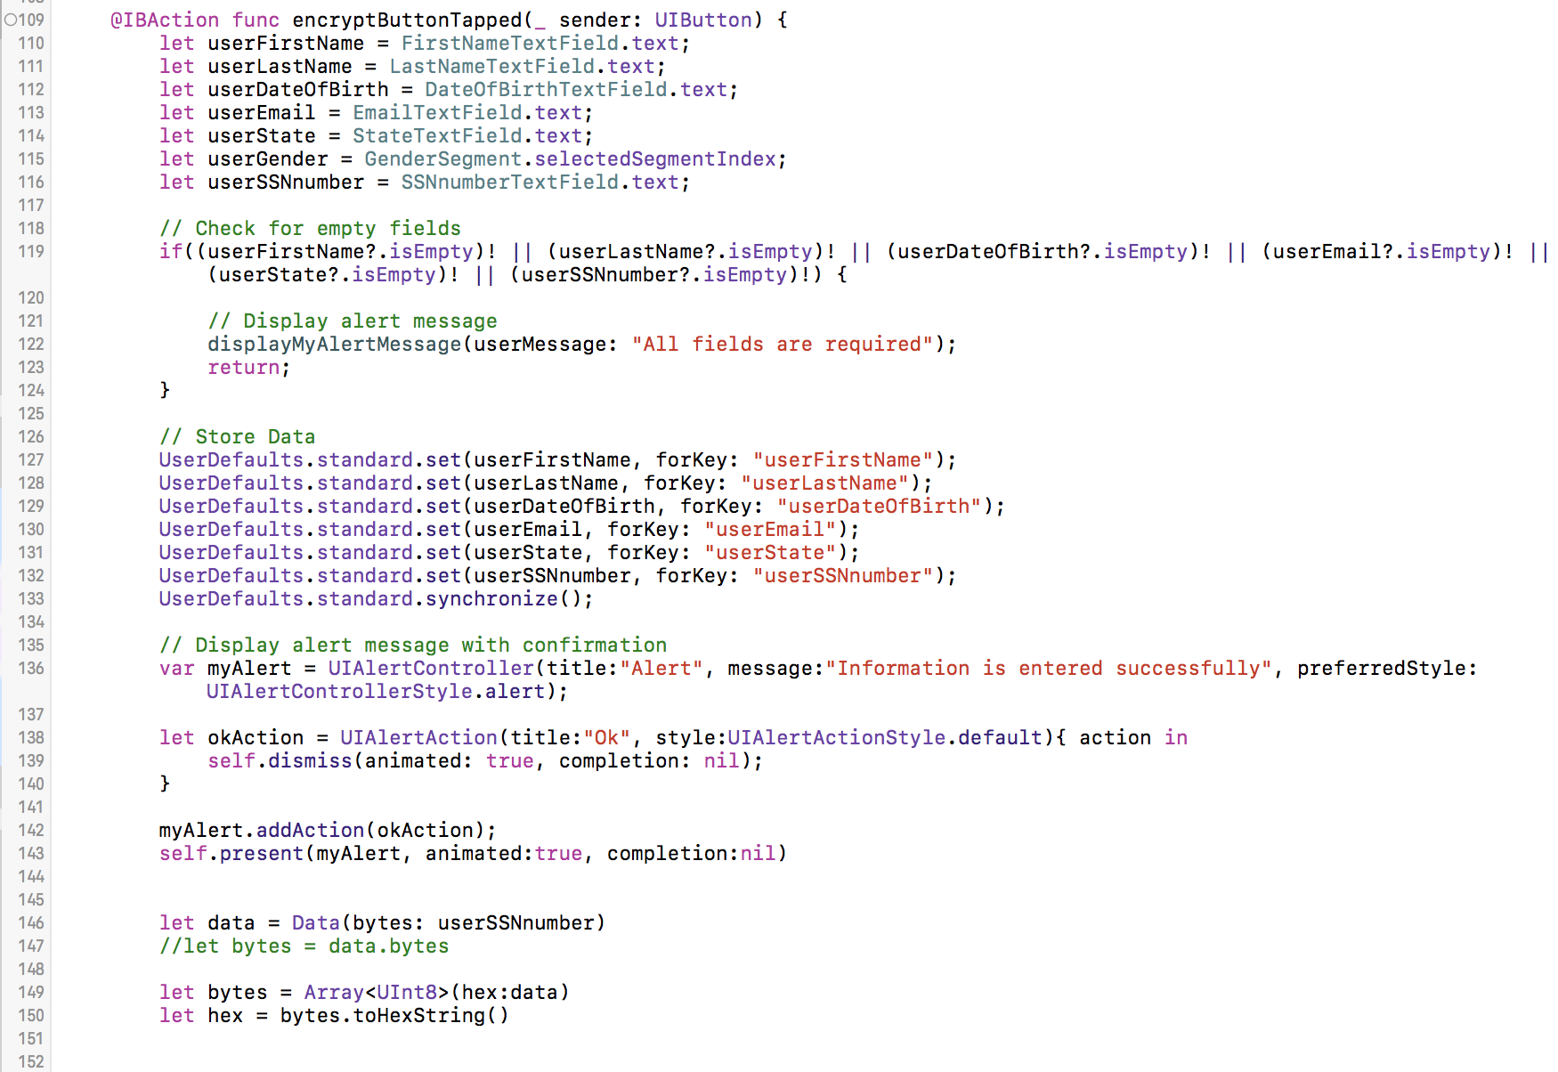
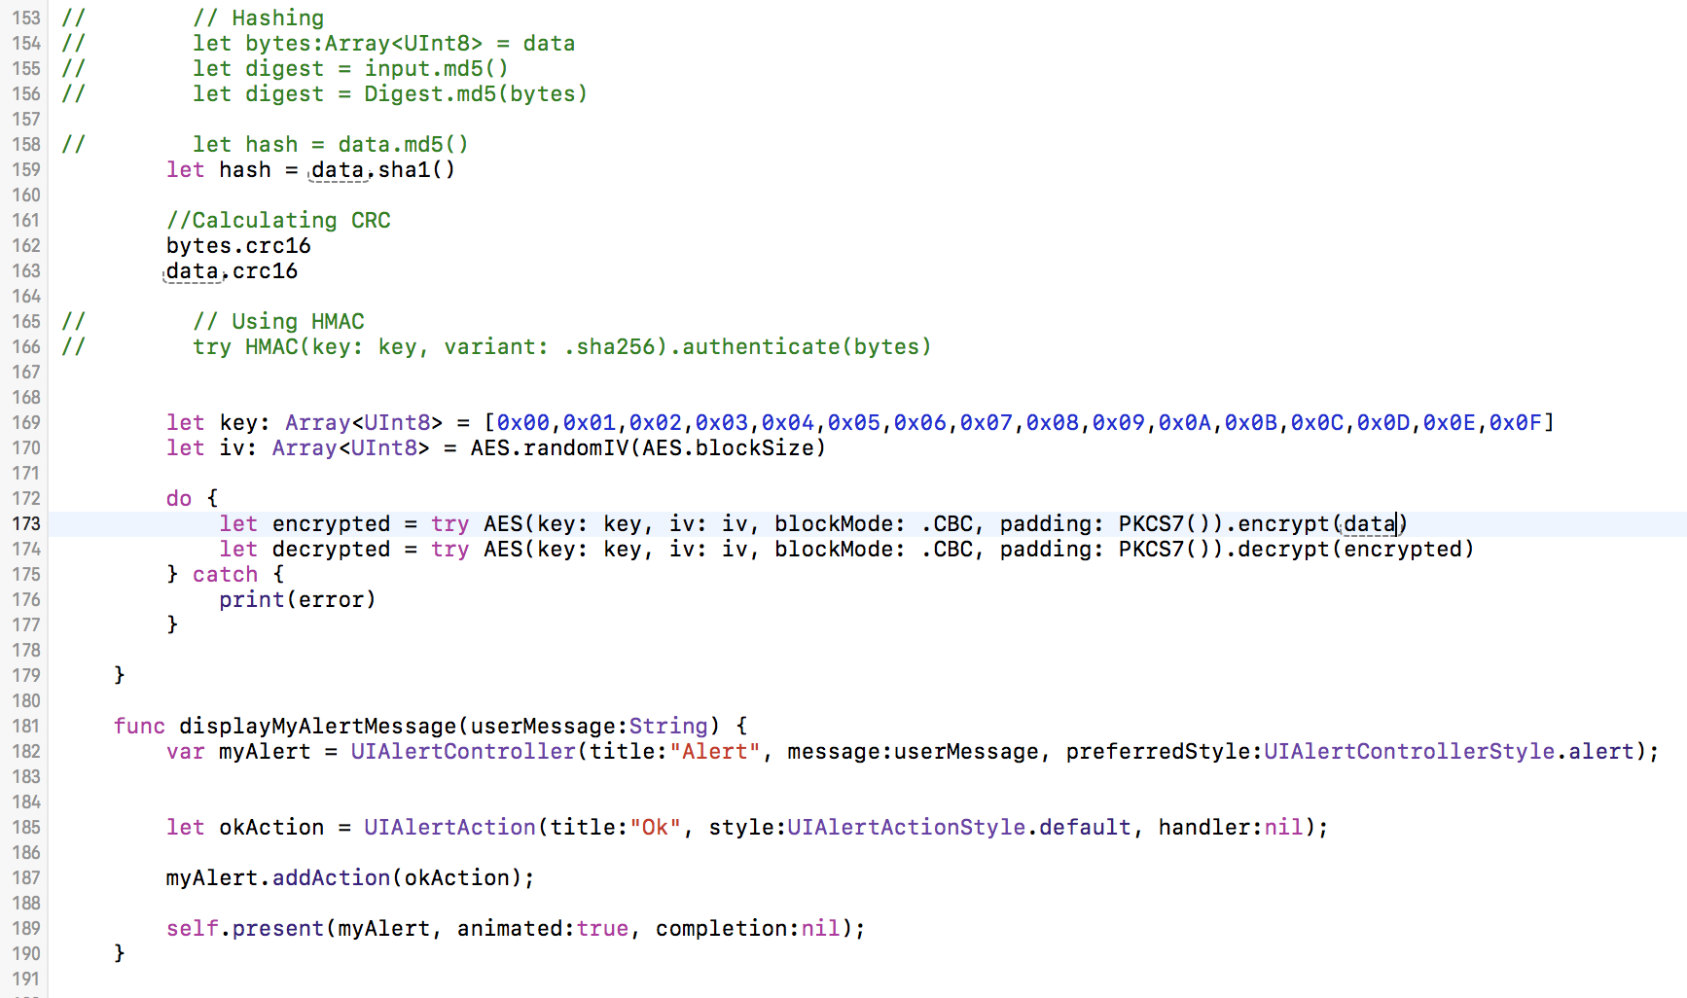

Slide 9
What I had to do
Learn using Xcode
Learn Swift Programming
Build up an own algorithm for encryption
Was I successful?
Not completely. The encryption algorithm I tried was’nt functioning properly
So I had to use a package ‘CryptoSwift’

Slide 10
Resources and References
Youtube tutorials (a lot)
krzyzanowskim/CryptoSwift
https://news.realm.io/news/swift-summit-marcin-krzyzanowski-cryptoswift-cryptography/

Slide 11
Thank you

